Slide 1
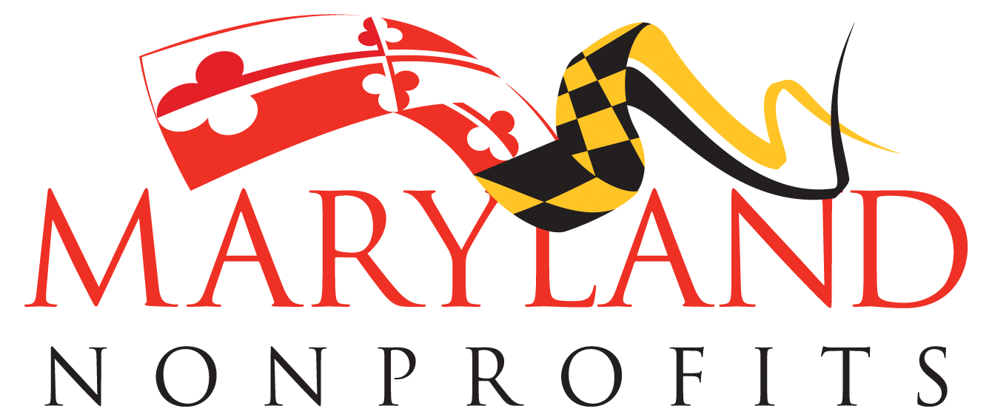
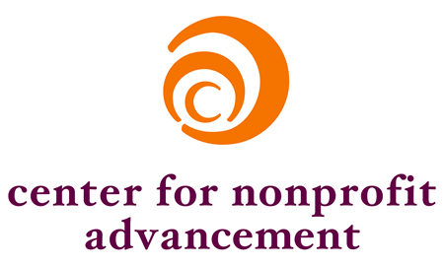
Nonprofits Count
The Economic & Social Impact of Nonprofits in Maryland, the District of Columbia and Virginia, 2016
a joint report by
Special thanks to Johns Hopkins Center for Civil Society Studies

Slide 2
Overview
Background
Nonprofits by the Numbers: Size & Scope
Economic Impact:, Employment, Wages & Expenditures
Philanthropy
Volunteerism
Challenges & Successes
Notes:
We’ll be going over a bit about the background of this study, followed by a closer look at nonprofits by the numbers, the economic impact of the sector including, employment, wages, and expenditures; philanthropy, volunteerism, and finally the challenges and successes experienced by nonprofits in our region.

Slide 3
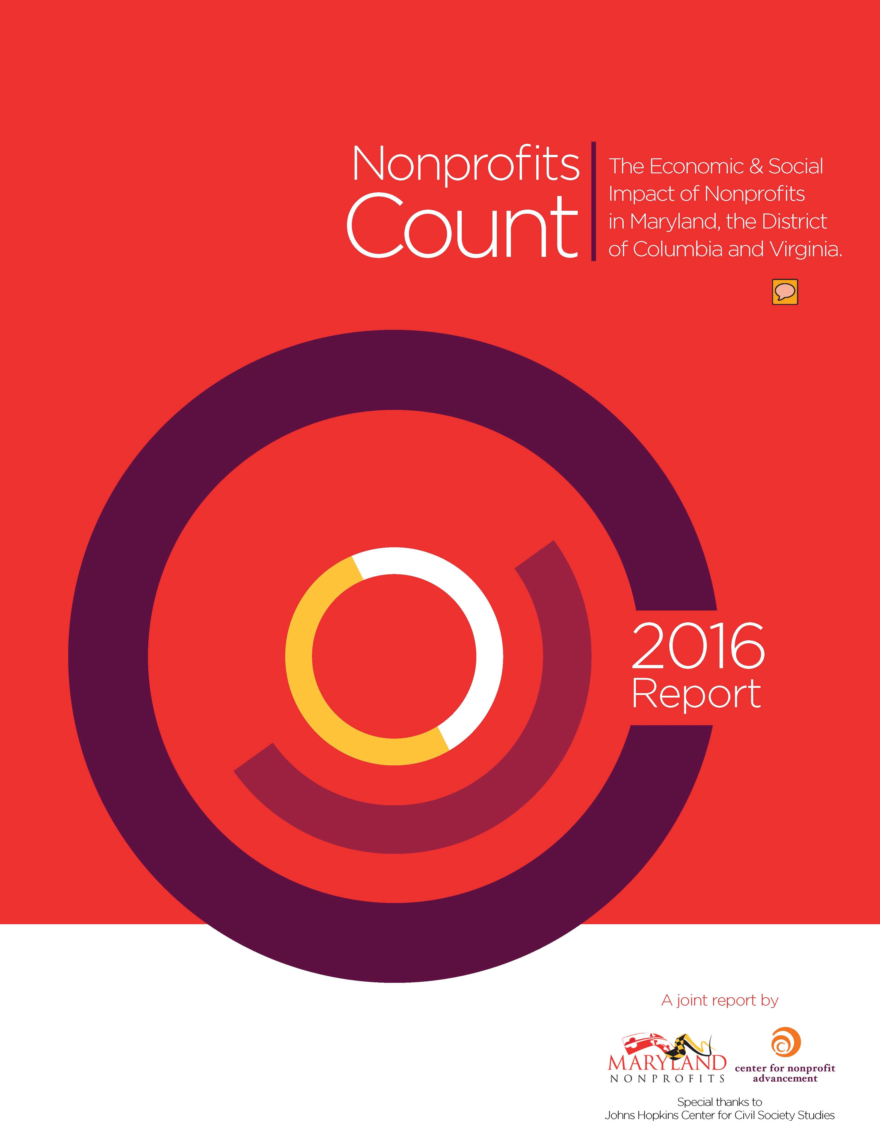
Background
First-ever regional report on the economic and social impact of nonprofit organizations in the State of Maryland, the District of Columbia, and the Commonwealth of Virginia
Notes:
Nonprofits, through our connecting role in communities, improve the quality of life for all in our Region. This first-ever report provides an in-depth look at the tremendous contributions of the nonprofit sector in the geographic region encompassing the District of Columbia and the states of Maryland and Virginia, from 2003 to 2014.

Slide 4
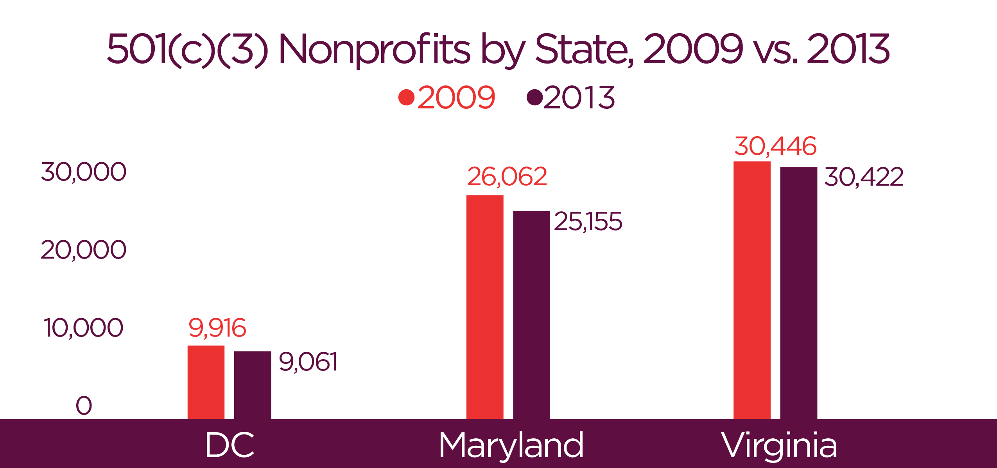
Nonprofits by the Numbers
Notes:
While the number of registered nonprofits decreased between 2009 and 2013, nonprofits have a significant presence in every county and city in the region. In 2013, there were almost 85,000 registered nonprofits in the District of Columbia, Maryland and Virginia, with almost 65,000 of them classified as 501c3s.

Slide 5
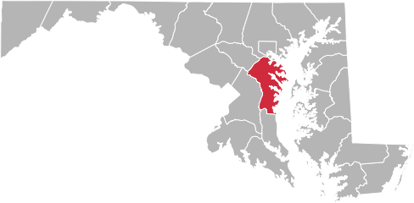
Nonprofits by the Numbers: Anne Arundel County, 2009 – 2014
1,831 out of 2,493
501c3s Registered
Nonprofits
18.7% growth in Registered Nonprofits
Notes:
In Anne Arundel County, there are almost 2,500 registered nonprofits, 1,831 of which are 501(c)(3)s.
**This slide is citing data from the Report NOT the 2014 Nonprofit by the Numbers website data.**

Slide 6
501(c)(3) Nonprofits by Field: Anne Arundel County, 2014
*Excluding 911 Unknowns/ Unclassified
Notes:
Nonprofit organizations work in a range of fields in Anne Arundel County. Among those 501(c)(3)s classified by the IRS in 2014, over 30 percent provide education services. Other large service delivery areas in the county include human services education; arts, culture and humanities; health; and organizations that focus on the environment and animals.
911 unknowns/unclassified

Slide 7
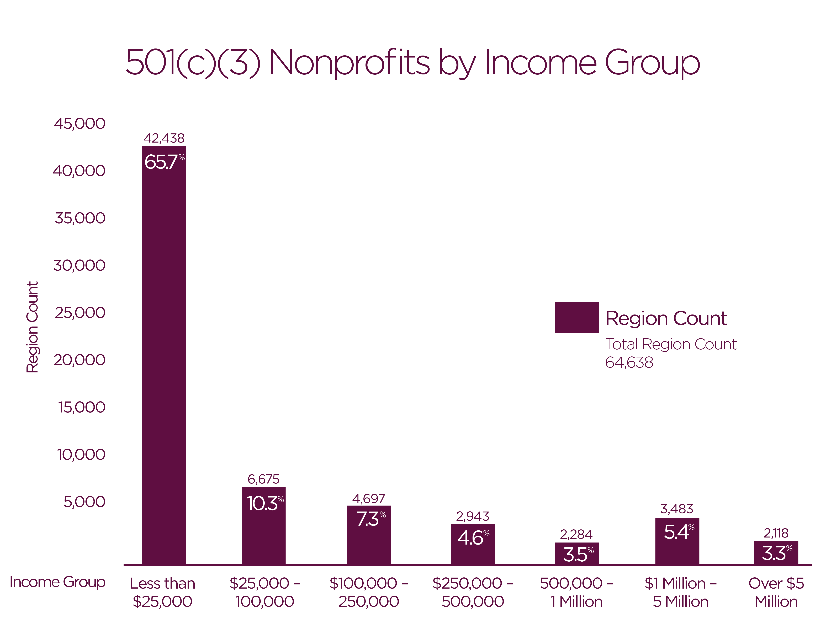
Nonprofits by Revenue
Notes:
The region’s nonprofits vary by revenue, and these revenue levels vary by state. Almost 66 percent of the region’s 501(c)(3)s operate with revenues of less than $25,000, and only 9 percent operate with revenues over $1 million.

Slide 8
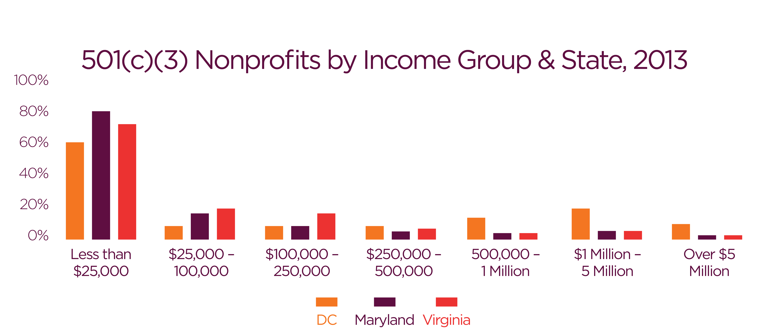
Nonprofits by Revenue & State
501(c)(3) Nonprofits by Income Group and State, 2013
Notes:
And when we break this down by state, we see that the percentage of 501(c)(3) organizations operating with revenues of $1 million or more was 18 percent in the District of Columbia — double the regional percentage.

Slide 9
501(c)(3) Nonprofits by Revenue: Anne Arundel County vs. State, 2014
Notes:
In Anne Arundel County, 66 percent of 501(c)(3)s operate with revenues of less than $25,000, 27 percent operate with revenues between $25,000 and $1 million, and only 7 percent operate with revenue over $1 million.

Slide 10
Economic Impact: Employment
Nonprofits employ 650,000 workers in Maryland, DC and Virginia
1 in 10 workers in the region
1 in 8 of the region's private workforce
Nonprofit employment increased on average by 11% in region from 2007 to 2012, while employment in for-profit sector decreased by -1.7%
Notes:
Nonprofits provide jobs! The sector employs almost 650,000 workers in the region — almost 10 percent of the region’s total workforce.
From 2007 to 2012, nonprofit employment in the region increased on average by 11 percent, while employment in the for-profit sector decreased during the same period by -1.7 percent. Employment growth was highest in Virginia who saw a 12% increase in number of workers over a 5 year period, followed by the District (with 11% growth) and Maryland (with 10% growth).

Slide 11
Anne Arundel County Employment, 2014
16,758 =
Total Nonprofit Workforce
6.6%
Total County Workforce
16.2%
Increase in nonprofit
employment over last
5 years
Notes:
The nonprofit job market in our cities and counties has also shown steady growth. Here in Anne Arundel County, in between 2009 and 2014, nonprofit employment increased by 16.2%.

Slide 12
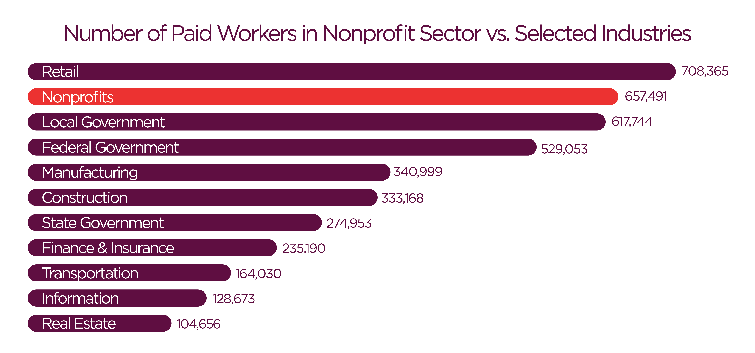
Employment Comparisons
Notes:
The nonprofit sector is the second largest industry in the region in terms of employment, behind only the retail industry. The region’s nonprofits employ:
Over six times as many workers as the real estate industry.
Slightly more than five times as many workers as the information industry.
Nearly four times as many workers as the transportation industry.
Two and three-quarters as many workers as the finance industry.
Over two and three-thirds as many workers as the state government.
Nearly twice as many workers as the construction and the manufacturing industry.

Slide 13
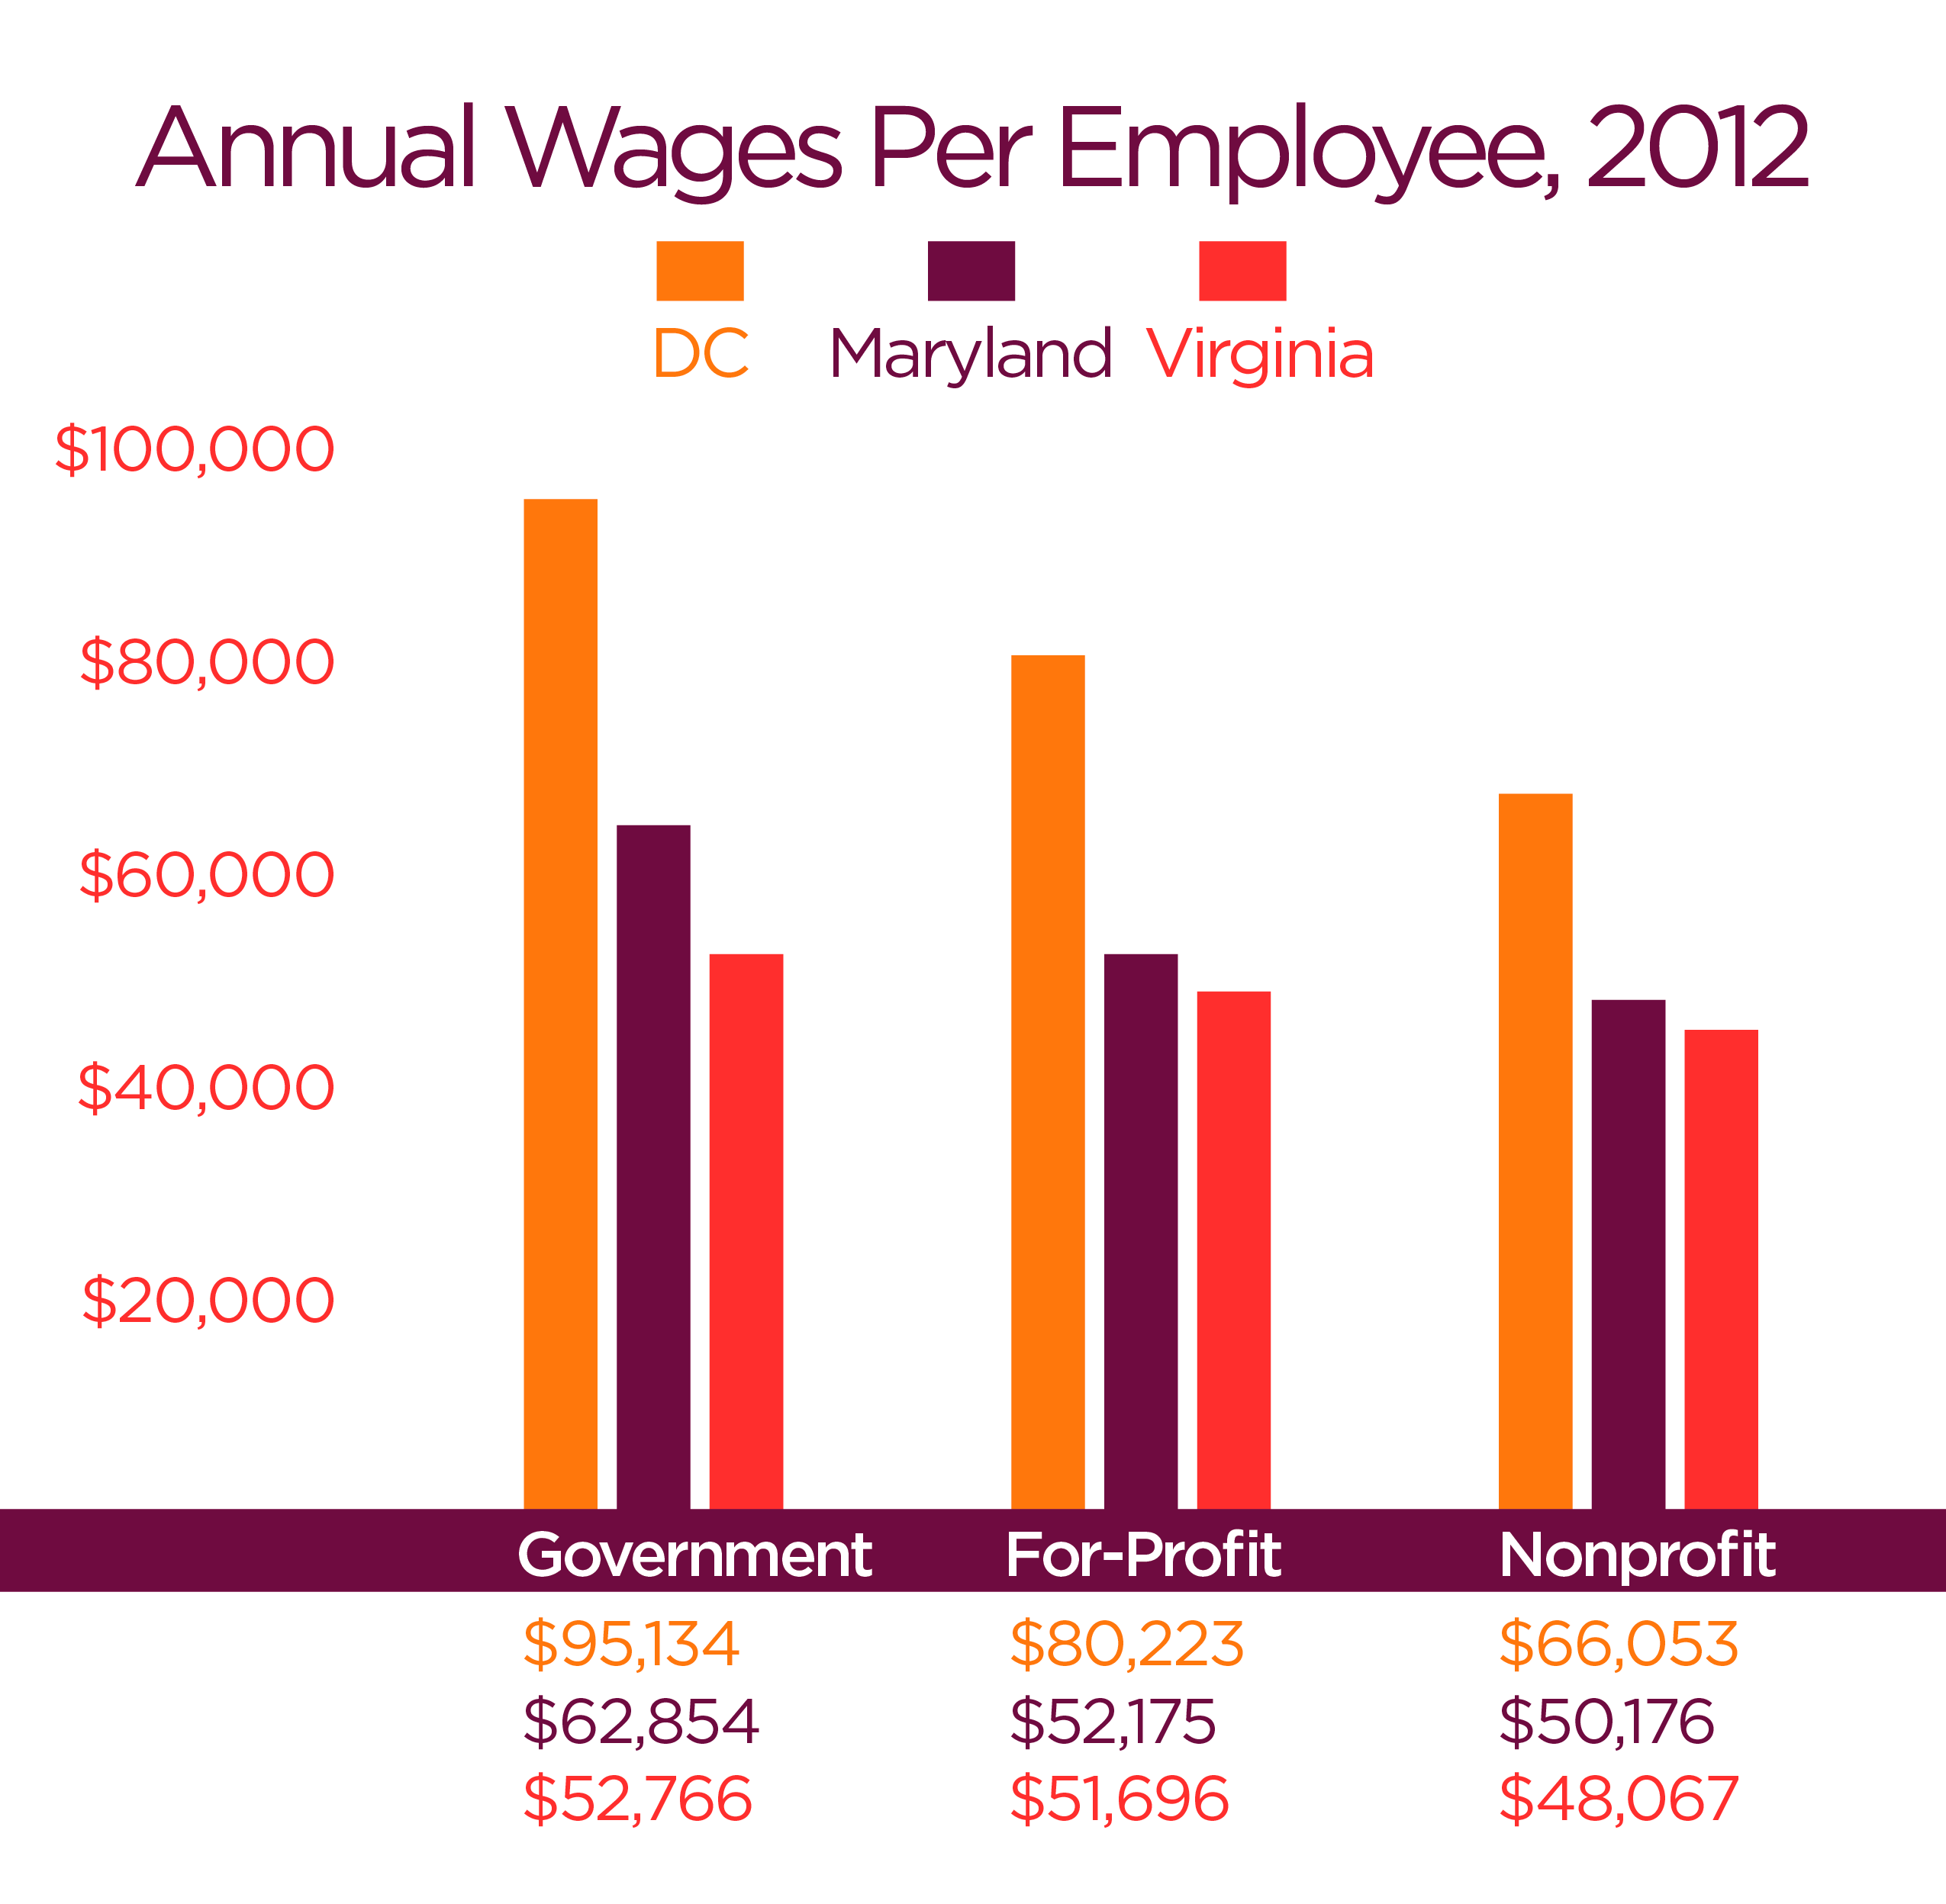
Economic Impact: Wages
Notes:
Along with growth in the number of jobs in the region, the wages paid to workers in the nonprofit sector continue to grow. These wages have an economic effect in the region, as workers in turn use their wages to pay income, sales, and property taxes, and to generate revenue for other businesses in the purchasing of food, vehicles, homes, and other goods and services.
In 2012, the average annual wages of nonprofit employees in the region was $54,766, up from $47,272 in 2007 — a 16% increase in wages. Annual wages were highest among employees working in nonprofits in the District of Columbia, where wages averaged slightly over $66,000 in 2012.

Slide 14
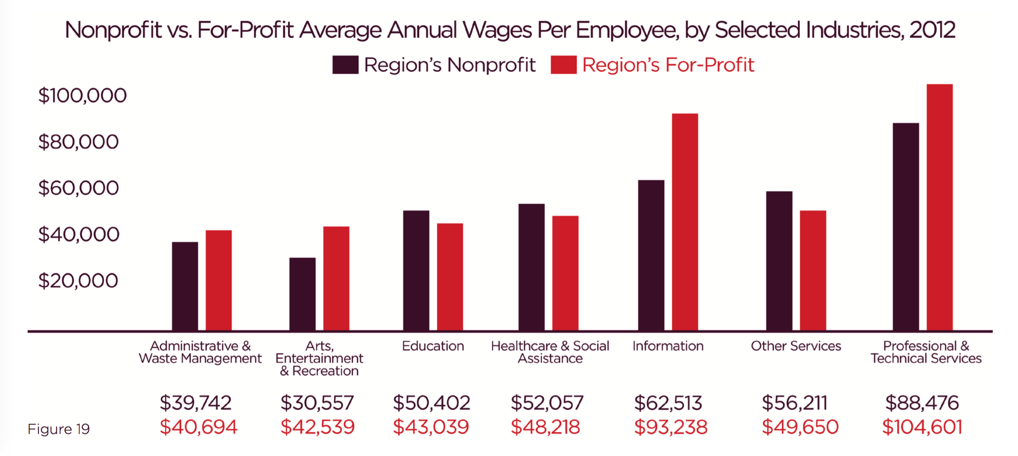
Wages per Industry Comparisons
Notes:
Average annual wages were highest among nonprofit employees working in the professional and technical service fields. Further, nonprofit employees working in the fields of Education, and Healthcare and Social Assistance had higher average annual wages than their for-profit counterparts in these fields.

Slide 15
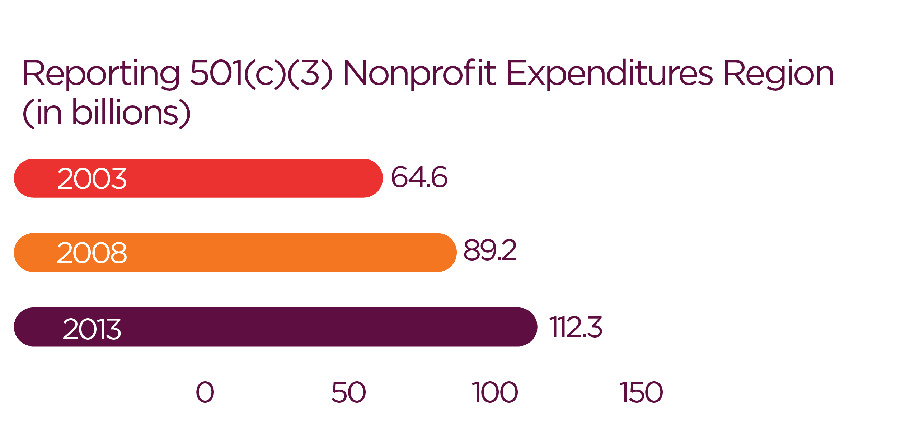
Economic Impact: Expenditures
Notes:
The region is home to 23,471 501(c)(3) nonprofits that file annual financial reports to the IRS – these are categorized in the report as ‘reporting nonprofits’. In 2013, these nonprofits spent a total of $112.3 billion dollars, contributing to 12% of the region’s gross domestic product. Nonprofit spending in the region increased by almost 75% from 2003 to 2013, with an average growth of almost 6% annually.
In Maryland, reporting nonprofits (8,327) spent a total of $40.7 billion dollars in 2013, and the 642 reporting nonprofits in Anne Arundel contributed approximately $1.4 billion dollars to the County’s economy.

Slide 16
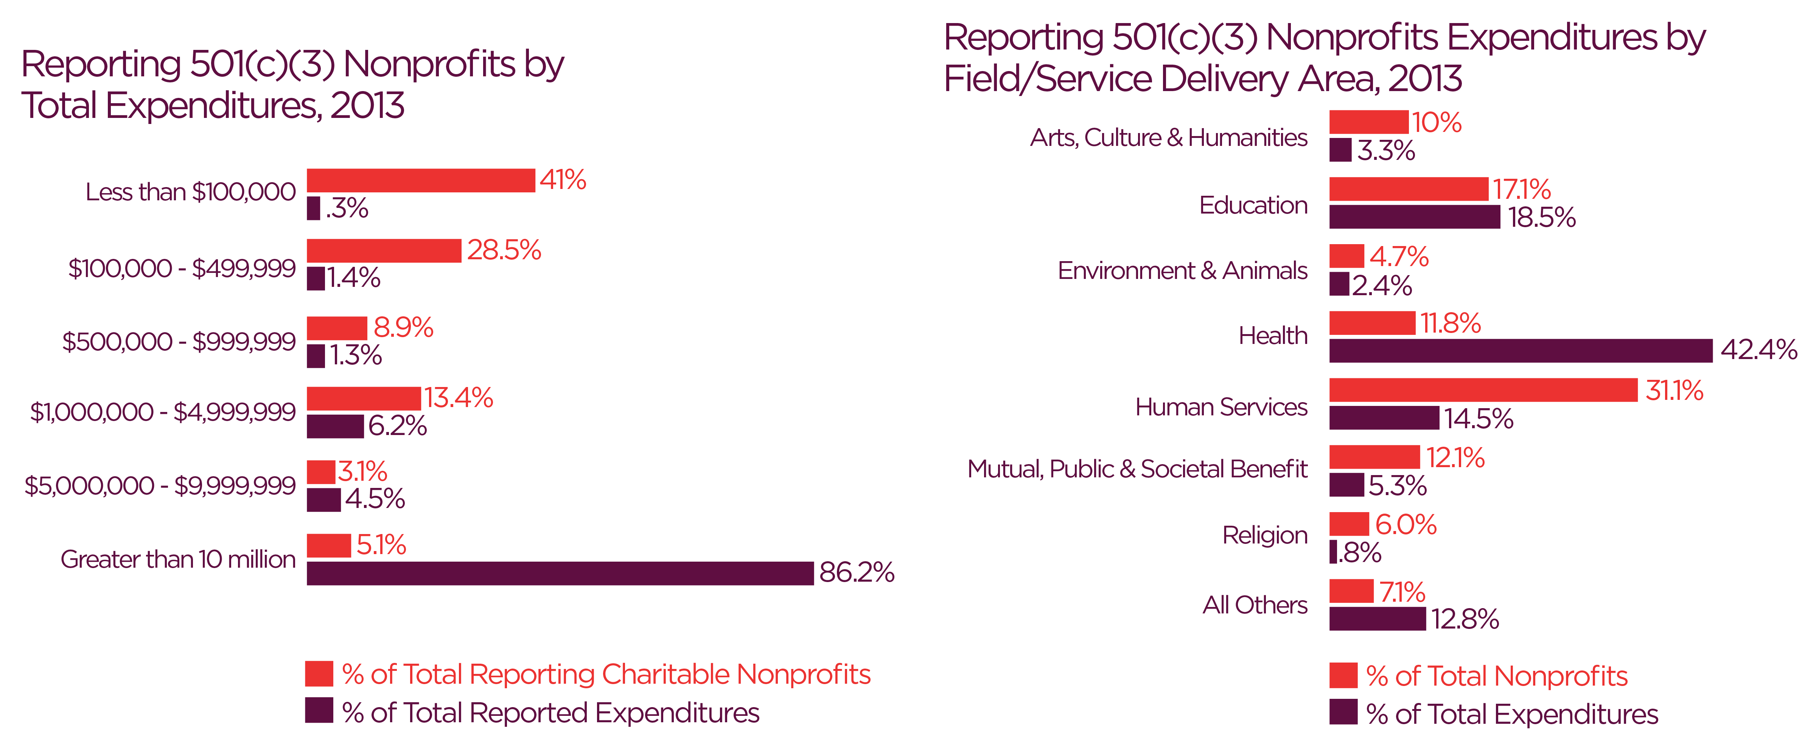
Expenditures by Size and Field
Notes:
As shown in these figures, the region’s largest nonprofits — those with annual budgets over $10 million — make up over 85% of the total expenditures of all reporting organizations in the region. Healthcare organizations, which include hospitals, comprise 12% (2,779) of the region’s reporting nonprofits, but are responsible for 42% of the $112.3 billion in expenditures — making them vital economic engines for the region.
The region’s 7,288 human service organizations represent the largest percentage of reporting nonprofits and they account for 15% of the total expenditures.

Slide 17
Philanthropy
Notes:
Grants given by foundations are another way to measure the economic impact of the region’s nonprofits. The Foundation Center reports that there are 3,446 active private and community grantmaking foundations located in the region, the majority of which are independent foundations. In 2013, these foundations held $33.5 billion in assets and created economic impact by giving over $1.8 billion in grants, scholarships, and employee matching gifts.

Slide 18
Volunteers
3.4
422.6
9.5
Million
Volunteers
Million
Service Hours
Billion
Benefit to local economy
Notes:
Nonprofits, through people, impact their communities. Results from the 2014 Volunteering in America report show that there were approximately 3.4 million volunteers in the region in 2013, outnumbering the paid staff in the sector. These volunteers, ranging from board members to program providers and other roles, contributed more than 422.6 million hours of service, which represents an almost $9.5 billion benefit to the local economy.

Slide 19
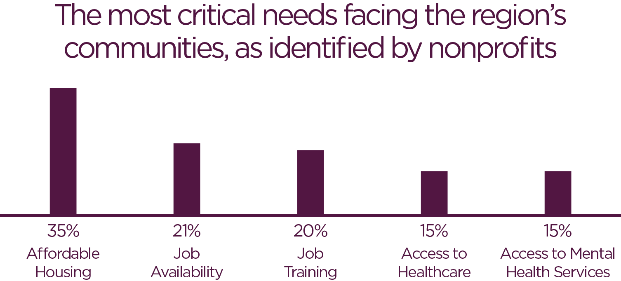
Increased Demand for Services
Notes:
Nonprofits continue to feel the strain of the economy and increasing demands for their services. In 2014, 37% reported an increased demand for their programs and services.
The most critical needs facing the region’s communities, as identified by nonprofits, include affordable housing (35%), job availability (21%), job training (20%), access to healthcare and access to mental health services (both 15%).

Slide 20
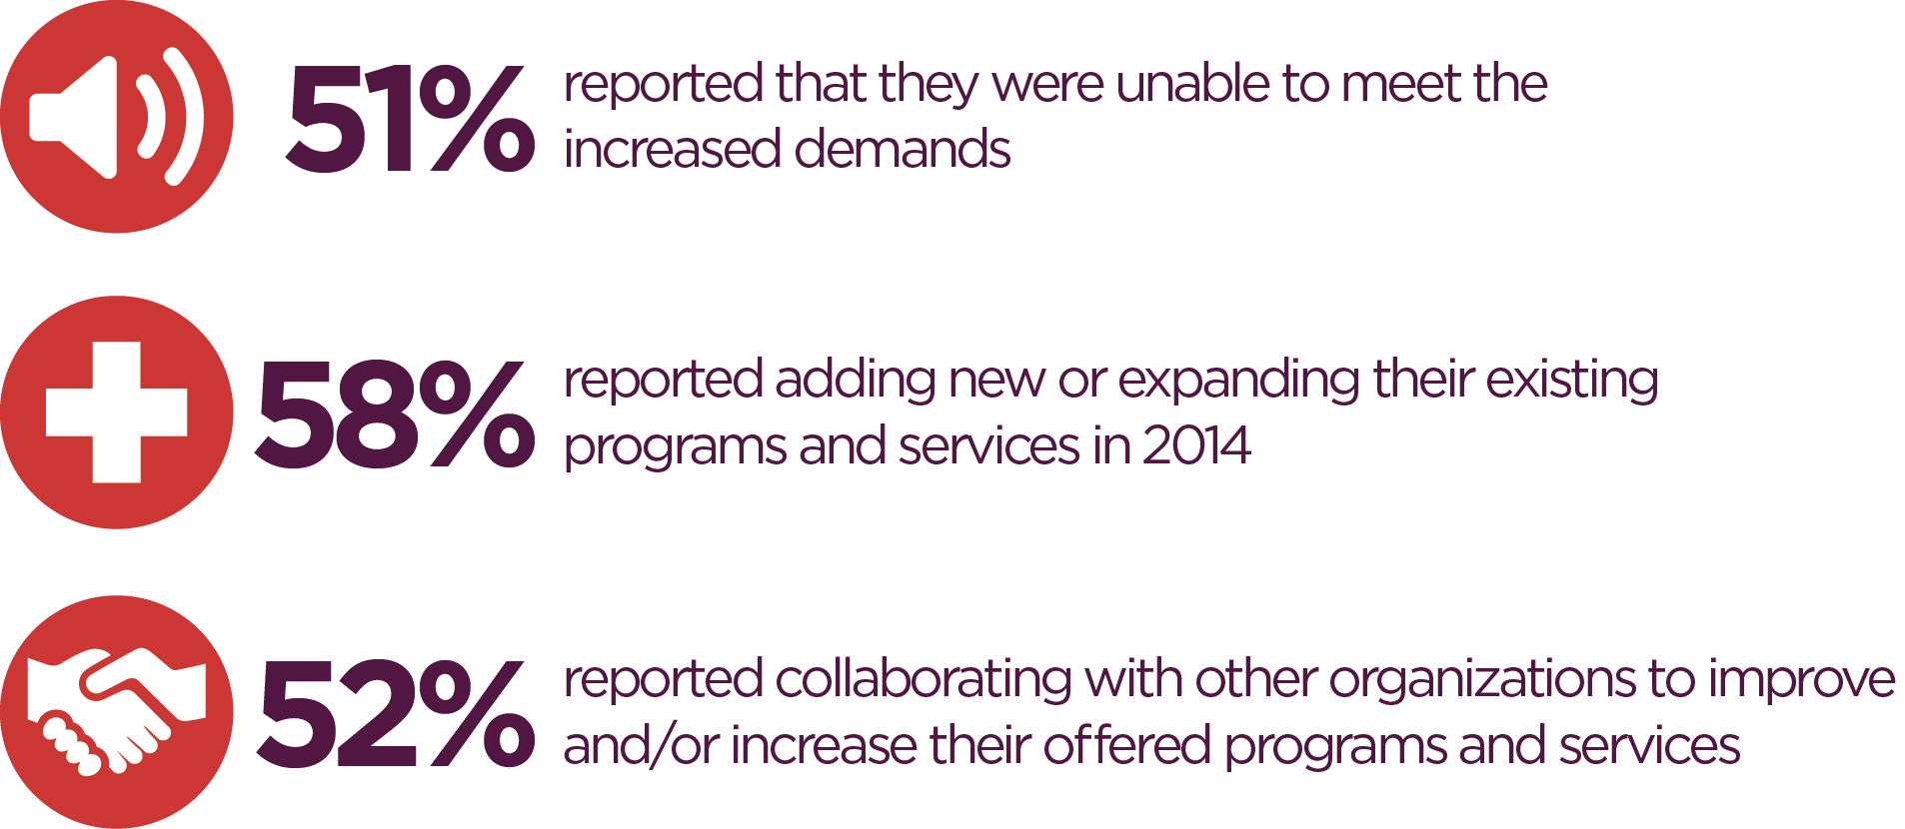
Increased Demand for Services
Notes:
The increase in demand for services make it a challenge for nonprofits to meet the growing needs in their communities. 51% of nonprofits in the region reported that they were unable to meet the increased demands for their programs and services. To respond to the increasing demands, 58% of nonprofits reported adding new or expanding their existing programs and services in 2014, and 52% reported collaborating with other organizations to improve and/or increase their offered programs and services.

Slide 21
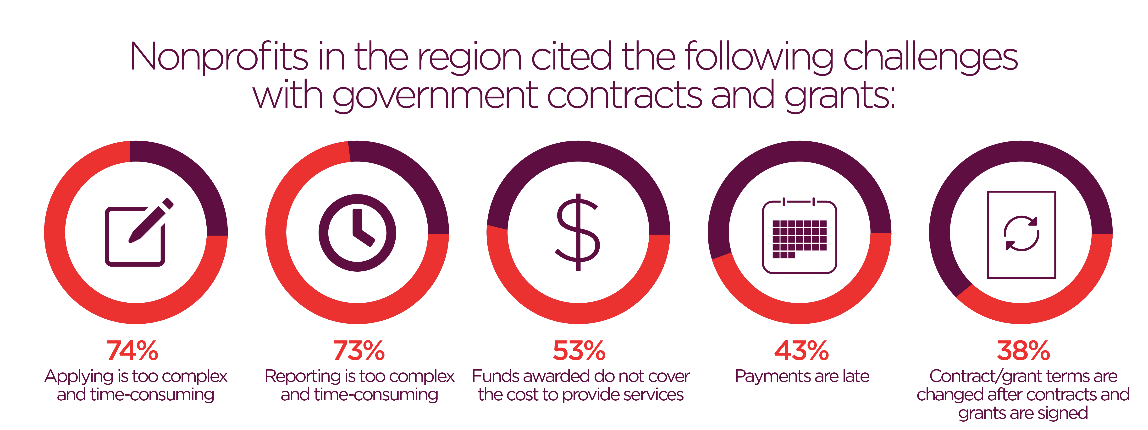
Financial Challenges
Notes:
Nonprofits across the region cited achieving long-term financial sustainability as their greatest financial challenge (34%). Other top financial challenges cited in 2014 included raising funding that covers full programmatic costs; raising unrestricted funding revenue; offering competitive pay and/or retaining staff; and handling cuts in government funding.
As shown in this slide, approaches in contracting and grantmaking by funders also create financial challenges for nonprofits in the region. In 2014, nonprofits cited the following challenges with government contracts and grants at the federal, state and local levels: Over 70% reported that both applying and reporting processes are too complex and time-consuming; Over 50% reported that funds awarded did not cover the actual cost to provide services; and 43% reported routine delays in payment by government agencies.

Slide 22
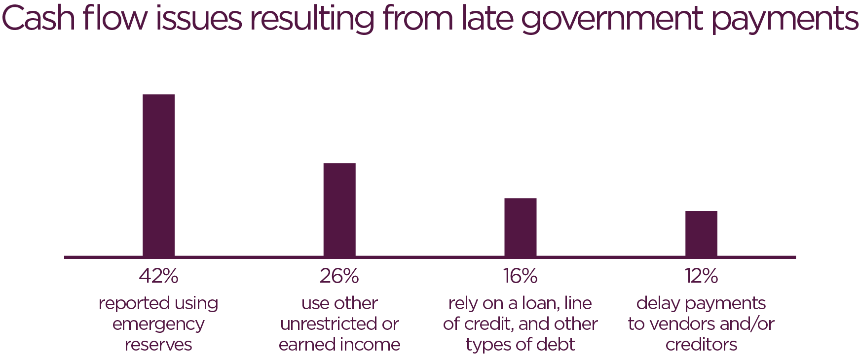
Cash Flow Challenges from Government Payment Delays
Notes:
Late government payments present a real problem for nonprofits. To manage cash flow issues resulting from these delays, 42% of nonprofits in the region reported using emergency reserves; 26% used other unrestricted or earned income; 16% relied on a loan, line of credit, and other types of debt; and 12% delayed payments to vendors and/or creditors.

Slide 23
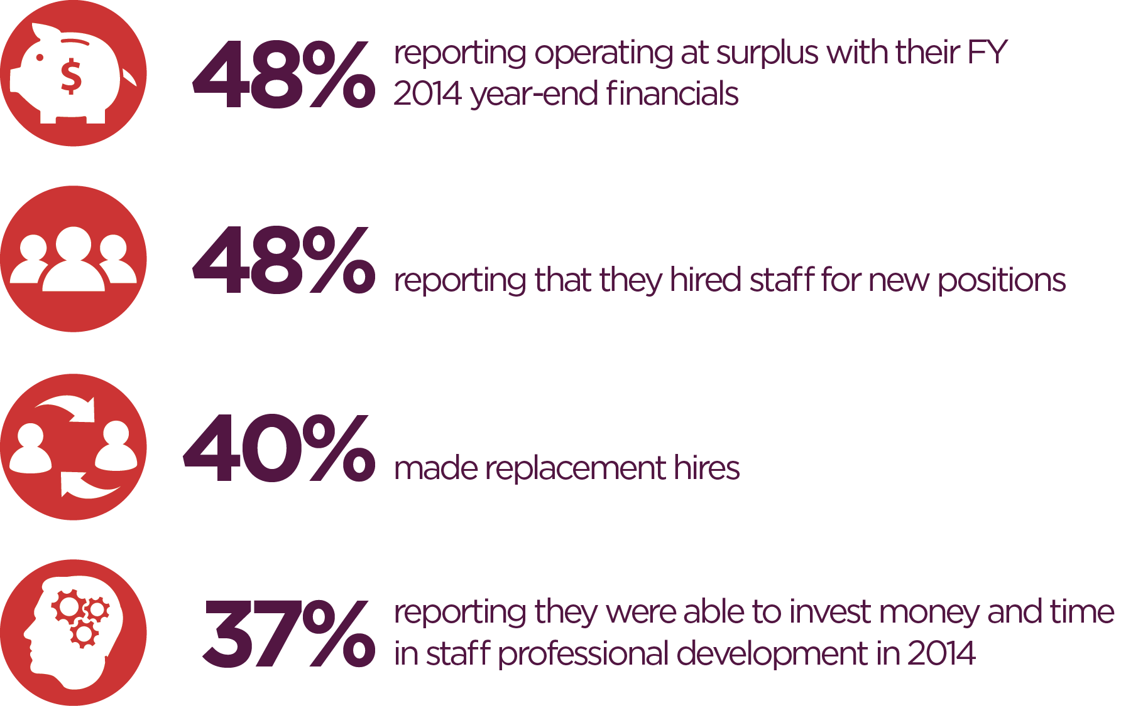
Nonprofits Positive Signs of Economic Recovery
Notes:
Despite the financial and funding challenges faced by the region’s nonprofits, many are showing positive signs of economic recovery, with 48% reporting operating a surplus with their FY 2014 year-end financials. Nonprofits are also making investments in their human capital, with 48% reporting that they hired staff for new positions, 40% making replacement hires, and 37% reporting they were able to invest money and time in staff professional development in 2014.

Slide 24
Conclusions
Vibrant and engaged nonprofit community =
Essential to Anne Arundel County, Maryland, and the Region
Notes:
Nonprofits are essential to advancing the quality of life for all in the Region. In Anne Arundel County alone, the nonprofit sector plays a crucial role by providing almost 17,000 jobs, delivering an enormous range of services to citizens of the region through its almost 2,500 education, human services, health, arts, spiritual support, and other community organizations, and adding more than $1.4 billion dollars directly to the County’s economy.

Slide 25
Conclusions
Deeper collaboration and long-term financial sustainability =
Strong nonprofit sector and greater impact
Notes:
While the demand for the services nonprofits provide continues to grow, they also continue to be affected by the decline in public spending and other financial and operational challenges. To better meet growing community needs and increase organizational efficiency while remaining significant employers and economic contributors, nonprofits in Anne Arundel County need deeper collaboration with and connection to other nonprofits, local businesses, government agencies, elected officials and residents to strengthen their collective capacity and achieve long-term financial sustainability.
It is my hope that the analyses presented today will increase awareness of and strengthen support of nonprofits and their tremendous contributions to the County and Region.

Slide 26
Using Nonprofits Count & Other Resources
Give copies to funders, colleagues, elected officials and government administrators
Invite a speaker
Use the findings in grant proposals, newsletters, and reports
Visit mdnonprofits.simplicitymetrics.com to get recent data on Maryland’s nonprofit sector
Contact research@mdnonprofit.org to conduct a study of your local nonprofit sector
Support efforts to “liberate nonprofit data”

Slide 27
Questions & Answers
Questions?
Notes:
Are there any questions?

Slide 28
To Learn More
Maryland Nonprofits
www.marylandnonprofits.org
The Center for Nonprofit Advancement
www.nonprofitadvancement.org
Notes:
To learn more about Nonprofits Count and to download additional copies of the report and the detailed appendix, please visit the Maryland Nonprofits and The Center for Nonprofit Advancement websites.

